Slide 1
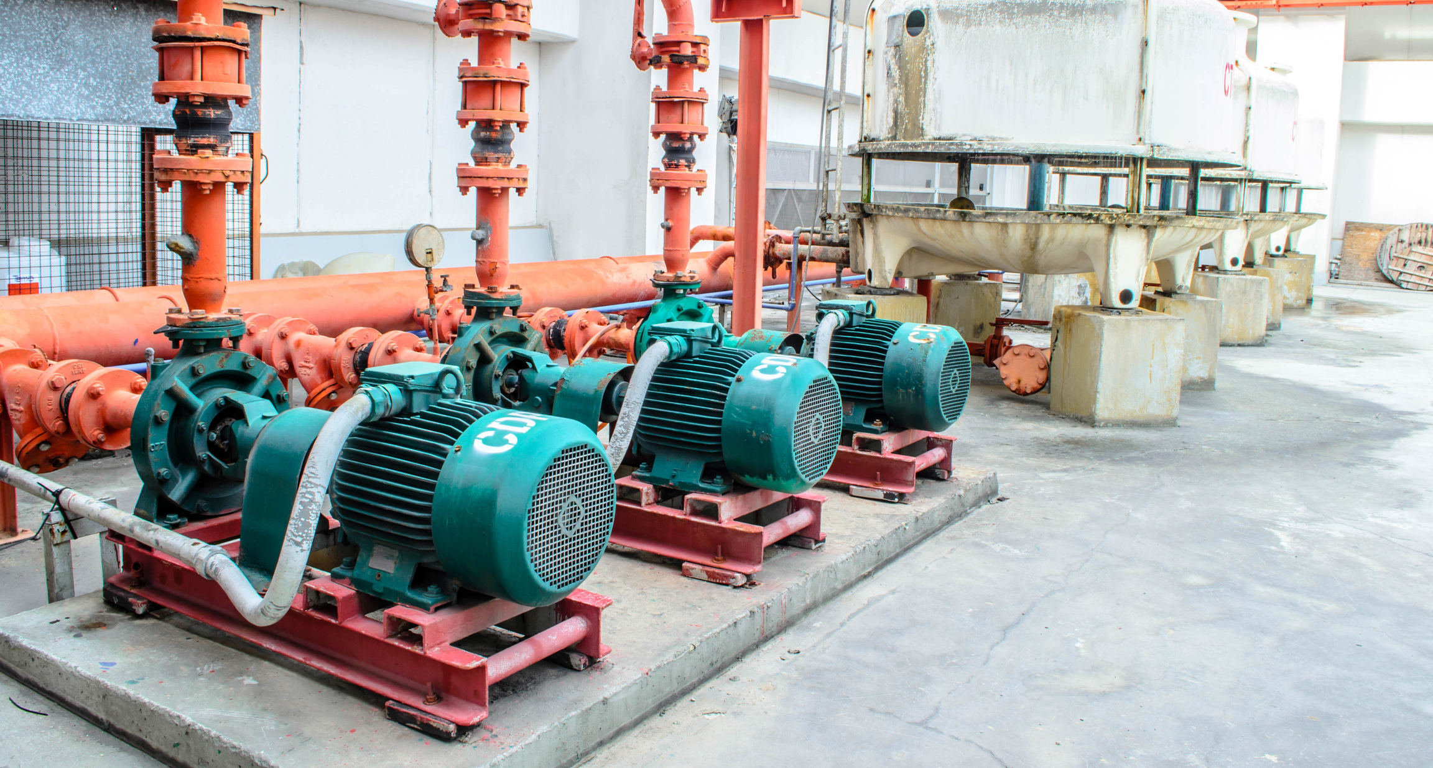
WECON TECHNOLOGY CO.,LTD
VARIABLE SPEED DRIVE PRESENTATION
High performance variable speed drive.
Wide range of applications with wecon products
Presented by:
Wecon Technology

Slide 2
Machine
Fan and Pump
HVAC
INDUSTRIES
Targeted Industries
Fan and Pump
Air Compressor
Washing Machinery
Plastic Machinery
Textile Machiner
VFD positioning
Vector enhanced inverter for mid-range industrial applications

Slide 3
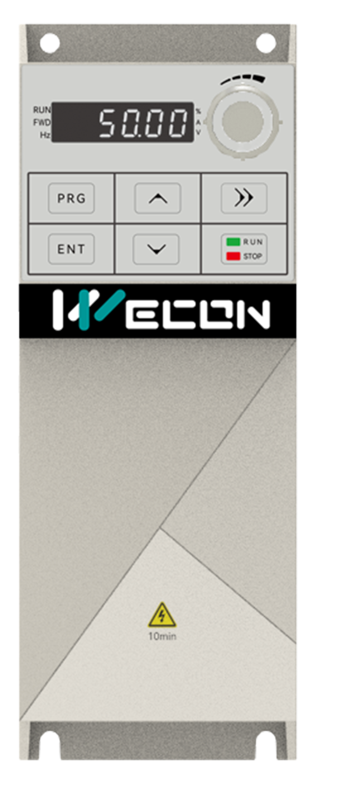
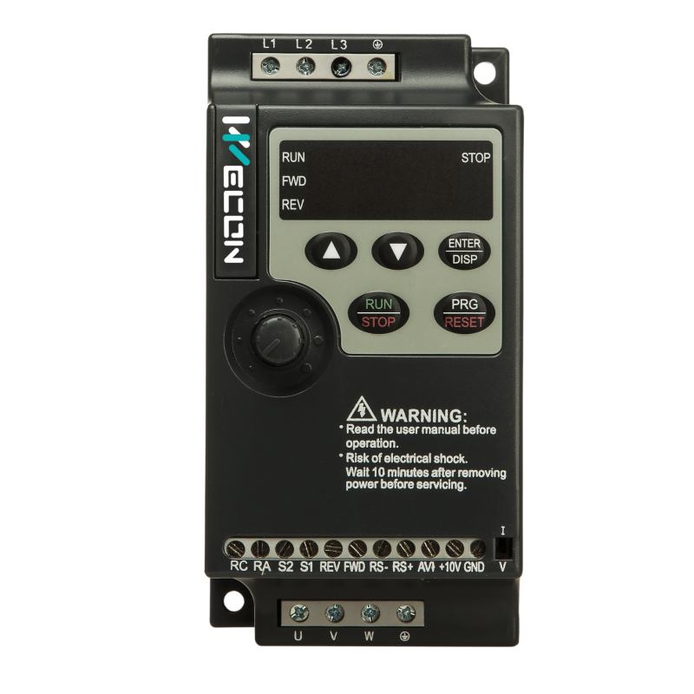
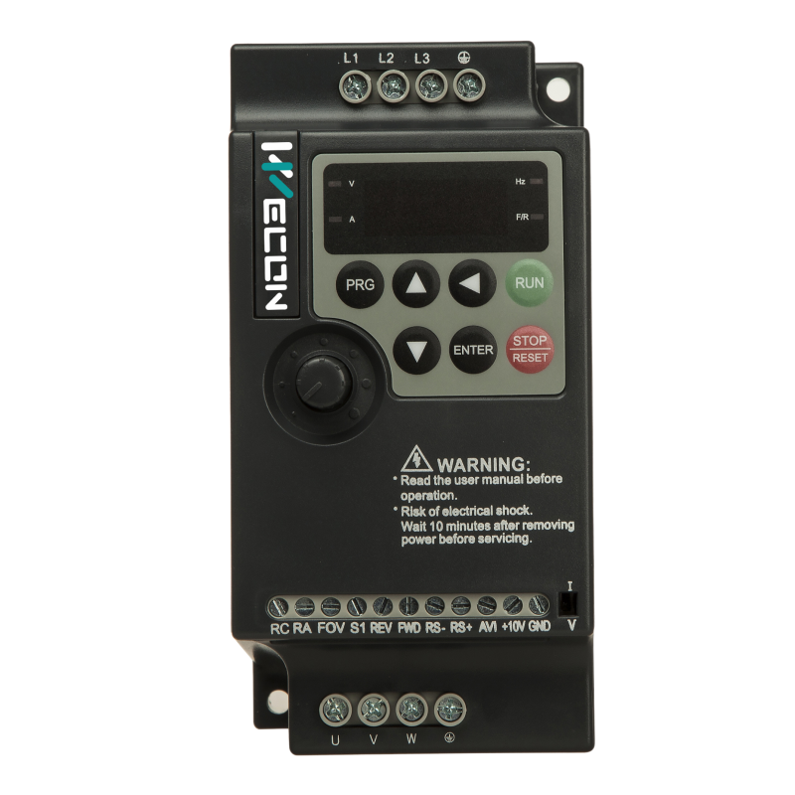
PRODUCT OVERVIEW
VFD SERIES
VM
VB
VC
VNZ100
VNZ200

Slide 4
VM SERIES
is an economic type VFD which is smaller size, easier commissioning and the flexibility makes it easy to be adjusted in parameters to control various mechanical equipment.
Small size, saving installation space
Compatible with guide rail, easy and quick to install
Multiple protection mechanisms, safe and secure
0-1000Hz output frequency range
150% overload for 60s.
Single-phase 220V : 0.75 - 2.2kW
Three-phase 380V : 2.2 - 7.5kW

Slide 5
Input power
VM HARDWARE
Supply input voltage : single phase , three phase
Operating display
LED Display status , Potentiometer adjust frequency , Button operate
I/O Interface
Supported 4 ch x Digital input ,
1 x Relay output
1 x Analog input (0..10V/4..20mA)
1 x Analog output (0..10V)
RS485 communication
RJ45 port supported RS485 Modbus RTU
Motor output
Terminal output power to motor U V W

Slide 6
MODEL SELECTION
VM - 2 S 1R5G
1
2
3
4
1
Series
2
Voltage
3
Input
4
Power
VM Series
2 : 220V
S : Single phase
1R5 : 1.5kW
4 : 380V
T : Three phase
R is decimal point

Slide 7
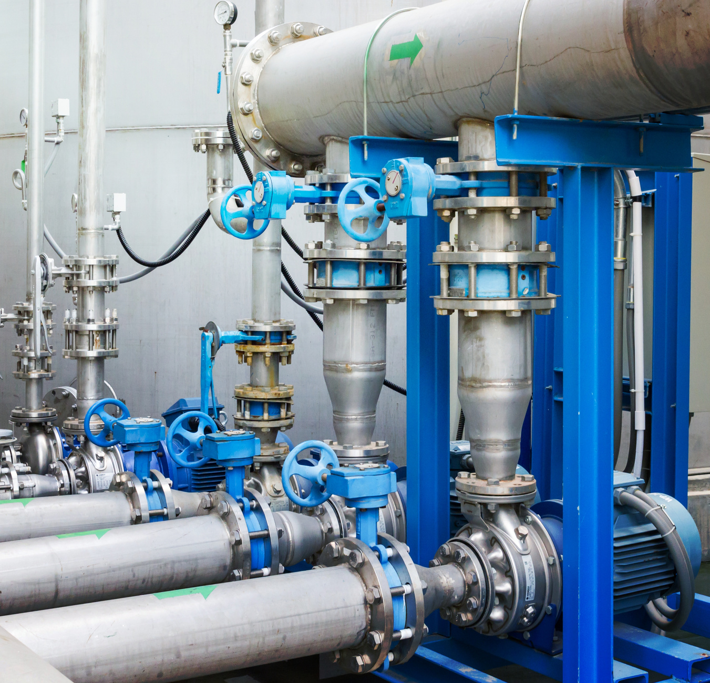
VB SERIES
is a new high-performance vector inverters to serve general-purpose that further enhances stability and reliability through hardware upgrades and optimization. It is best choice for complex applications.
SVC Control Mode:0-320Hz
Excellent Braking Function
Superior Control Performance,Optimized PID function
Short-circuit protection in power-to-GND
Support speed and torque control, low speed with high torque output
Single-phase 220V : 0.75 - 2.2kW
Three-phase 380V/415V/440V : 0.75 - 400kW

Slide 8
Control mode
Input Voltage
VB Series
Vector control(SVC)
Various supply voltage
Key Features
V/F mode:0-1000Hz
SVC mode: 0-320Hz
Single-phase 220V
Three-phase 380V/415V/440V
The VB series is a new high-performance vector general-purpose VFD that futher enhances stability and reliability through technical upgrades and product optimization and it is suitable for complex drives applications.
Robust design
Protection
Reliability
Long life time
The internal structure is more reasonable, the copper wire routing loop area is smaller, and drive reliability is higher.
Enhanced protection design.
Voltage and current safety function.
Temperature protection

Slide 9
MODEL SELECTION
VB - 4 T 18R5GB / 022PB
1
2
3
4
5
1
Series
2
Voltage
3
Input
4
Power 1
5
Power 2
VB Series
2 : 220V
S : Single phase
18R5 : 18.5kW
022 : 22kW
4 : 380V
T : Three phase
R is decimal point
G : Constant torque load
B : Built-in brake unit
R is decimal point
P : Variable torque load
B : Built-in brake unit

Slide 10
ROBUST
DESIGN
0.75 - 7.5 kW
ABS material
11 - 400 kW
Steel material
The unique air duct design has better dustproof effect and better heat dissipation effect.
High reliability design.
Standard protection IP20

Slide 11
 | Sensorless vector control (SVC) | V/F control
Starting torque | 0.5Hz/150% | 0.5Hz/100%
Speed range | 1:100 | 1:50
Stable speed accuracy | ±0.5% | ±1%
Power
VFD
MOTOR
CONTROL MODE
speed loop
compensation
Sensorless vector control

Slide 12
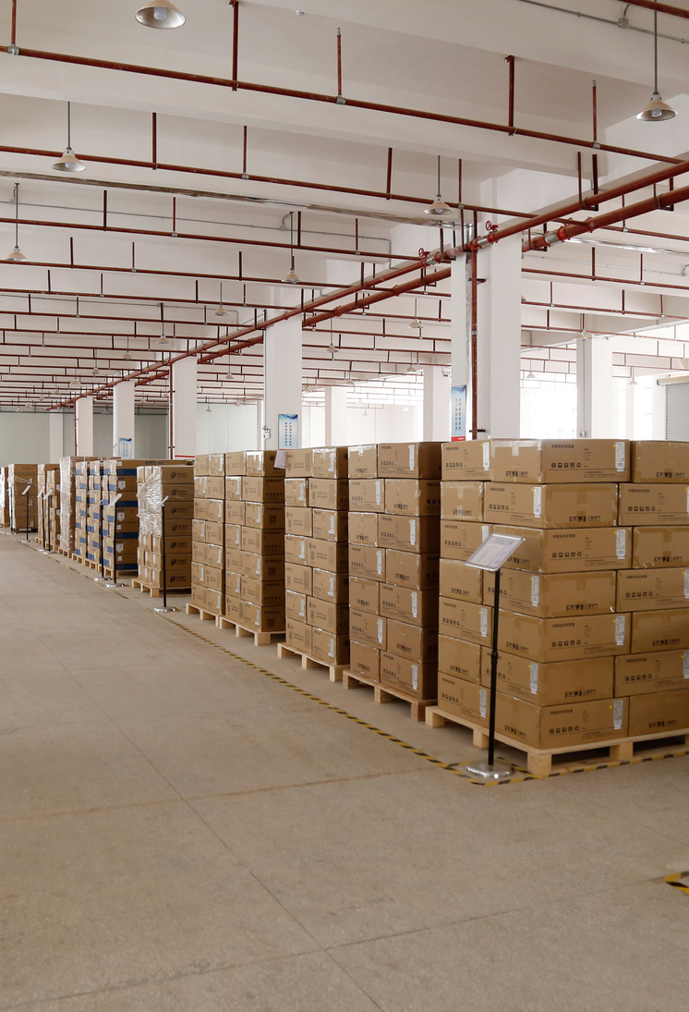
Factory
PRODUCTION
Certified standard
Assembly
QC/QA
Warehouse

Slide 13
VB HARDWARE
Operating display
LED Display status , Potentiometer adjust frequency , Button operate
I/O Interface
Supported 6 ch x Digital input ,
1 x Relay output
1 x Analog input (0..10V/4..20mA)
1 x Analog output (0..10V/4..20mA)
RS485 communication
upported RS485 Modbus RTU
Input power
Motor output
Supply input voltage : single phase ,
three phase
Terminal output power to motor U V W

Slide 14
VB WIRING

Slide 15
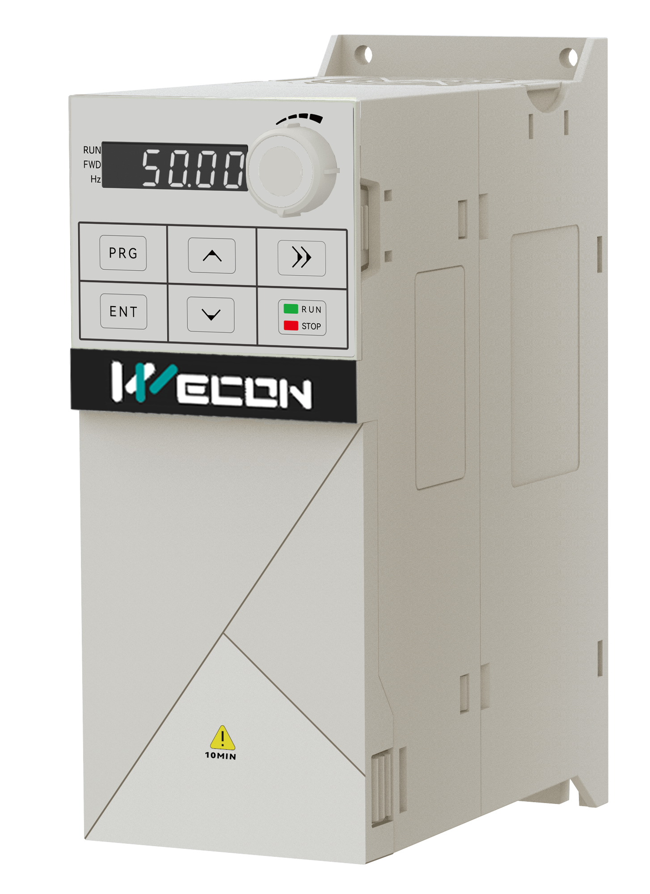
VC SERIES
VC Series VFD features a compact structure design for flexible installation. The upgraded main control chip offers better control. With standard multi-functional expansion interfaces, customizable expansion cards (Communication, IO, Incremental Encoder ) make them suitable for various applications.
Excellent control algorithm
Detachable Keyboard
Support flexible expansion
Wide voltage input
Compatible with synchronous / asynchronous motor
Compact structure design
Single-phase 220V : 0.75 - 2.2kW
Three-phase 380V/415V/440V/480V 0.75 - 37kW

Slide 16
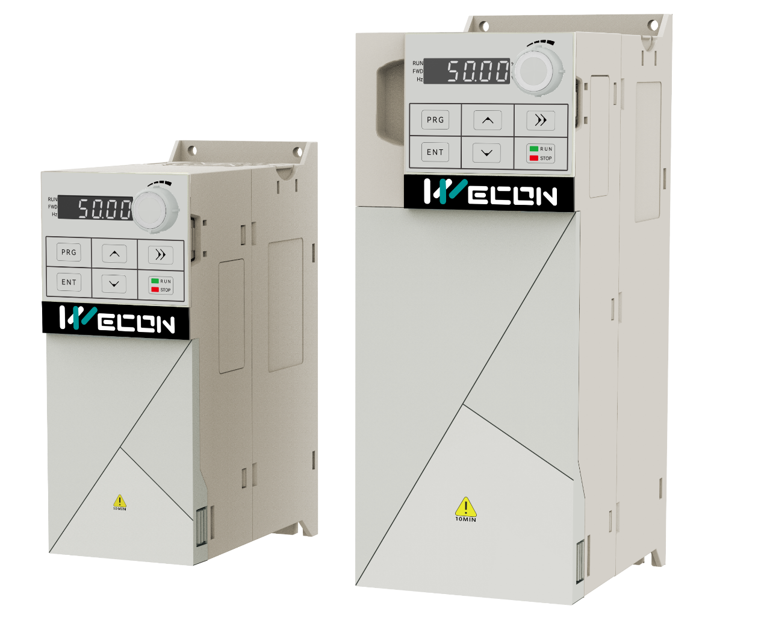
Narrow-body Structure
Input Voltage
VC Series
Various supply voltage
Advantage
Small size design saves installation space. Compared with VB series, the volume is reduced by 31% on average.
Single-phase 220V
Three-phase 380V/415V/
440V /480V
Allowable fluctuation:
220V-15% ~ 220V+15%
380V-15% ~ 480V+10%
Through technical development and improvement, VC series has more powerful functions
Efficiency Heat Dissipation
Expansion Module
Special features
New type of radiator design, reduce the overall volume
Extended IO;
Special protocol;
Encoder type

Slide 17
MODEL SELECTION
VC - 4 T 18R5 B - E
1
2
3
4
5
1
Series
2
Voltage
3
Input
4
Power 1
5
Power 1
VC Series
2 : 220V
S : Single phase
18R5 : 18.5kW
E: English version
4 : 380V
T : Three phase
R is decimal point
B: Built-in brake unit

Slide 18
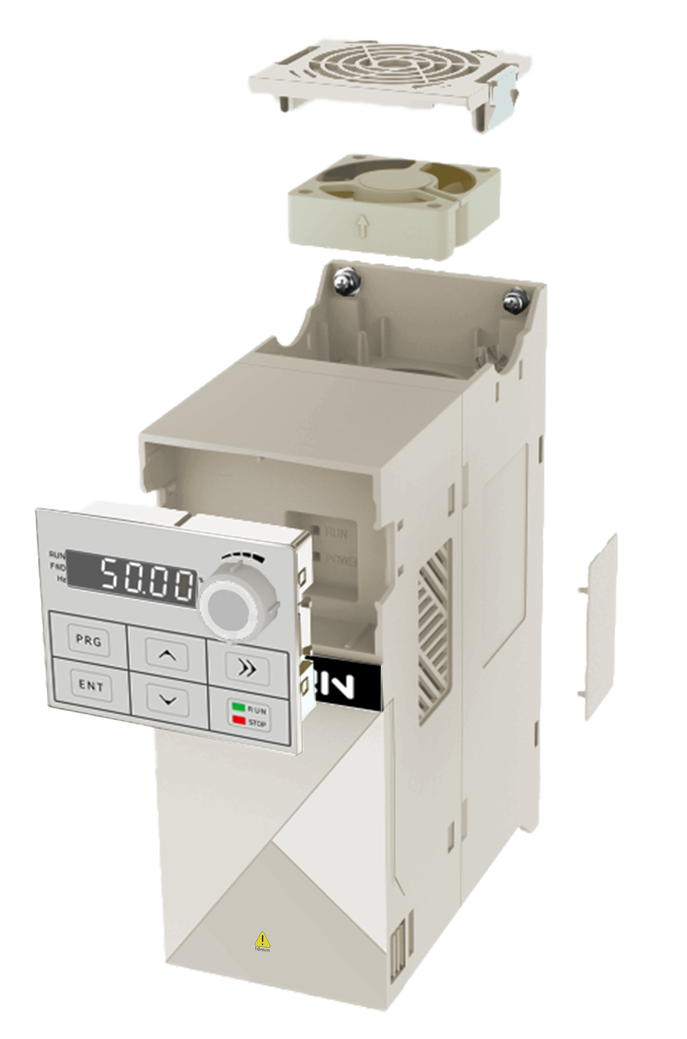
Main Features
【Independent Air Duct Design】
The entire series features an independent air duct design, enhancing product protection and preventing issues
【Easy Maintenance】
The cooling fan can be removed independently without complicated operations.
【Detachable Keyboard】
The entire series comes standard with a detachable keypad, making it easy to use with the control cabinet for simple external references.
【Flexible Protection】
The entire series comes standard with side ventilation openings, which enhance heat dissipation while reducing condensation in high-humidity environments. When paired with dust-proof covers, it also minimizes the impact of dust and other foreign particles in more complex settings.
【Back Dimensions Diagram】
The plastic backplate includes installation hole dimension diagrams, facilitating the installation process.

Slide 19
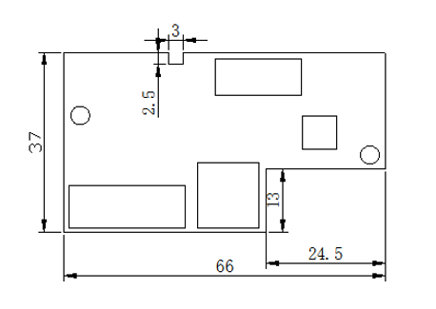
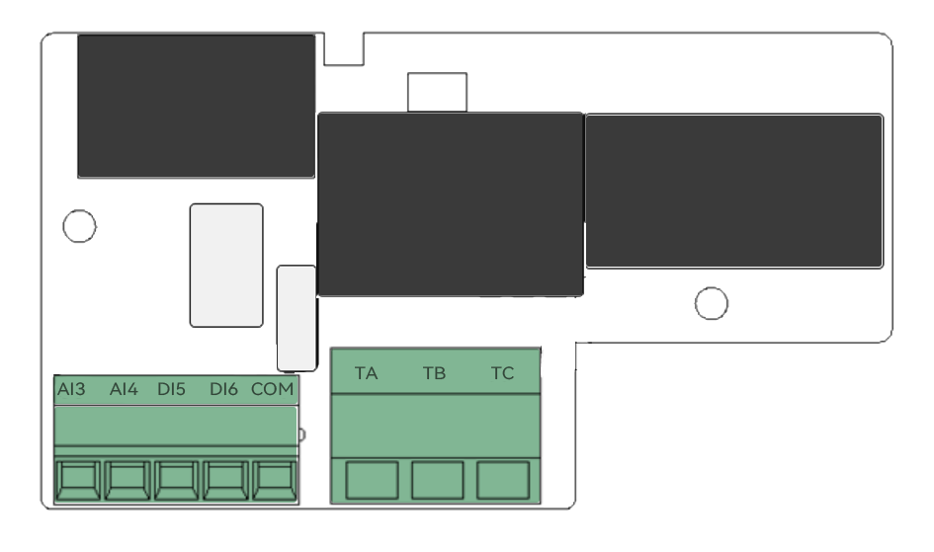
Expansion Module
01
Extended IO terminal
02
Communication protocol: Ethercat/Profinet
03
Incremental optical encoder; Incremental rotary encoder

Slide 20
Expansion Module
Type | Model | Describe
I/O | EX-IO01-STM | Standard IO Expansion module MCU edition
Communication | EX-EC | EtherCAT communication protocol
 | EX-PN | ProfiNet communication protocol
Incremental Encoder | EX-PGIP | Incremental photoelectric encoder
 | EX-PGRT | Incremental rotary encoder

Slide 21
Compare with VB and VM
 | VM | VB | VC
High input voltage |  |  | √
external keyboard | √ | √ | √
PG module |  |  | √
Built-in brake unit |  | 0-22kW | 0-37kW
DC input |  | √ | √
P, G model |  | √

Slide 22
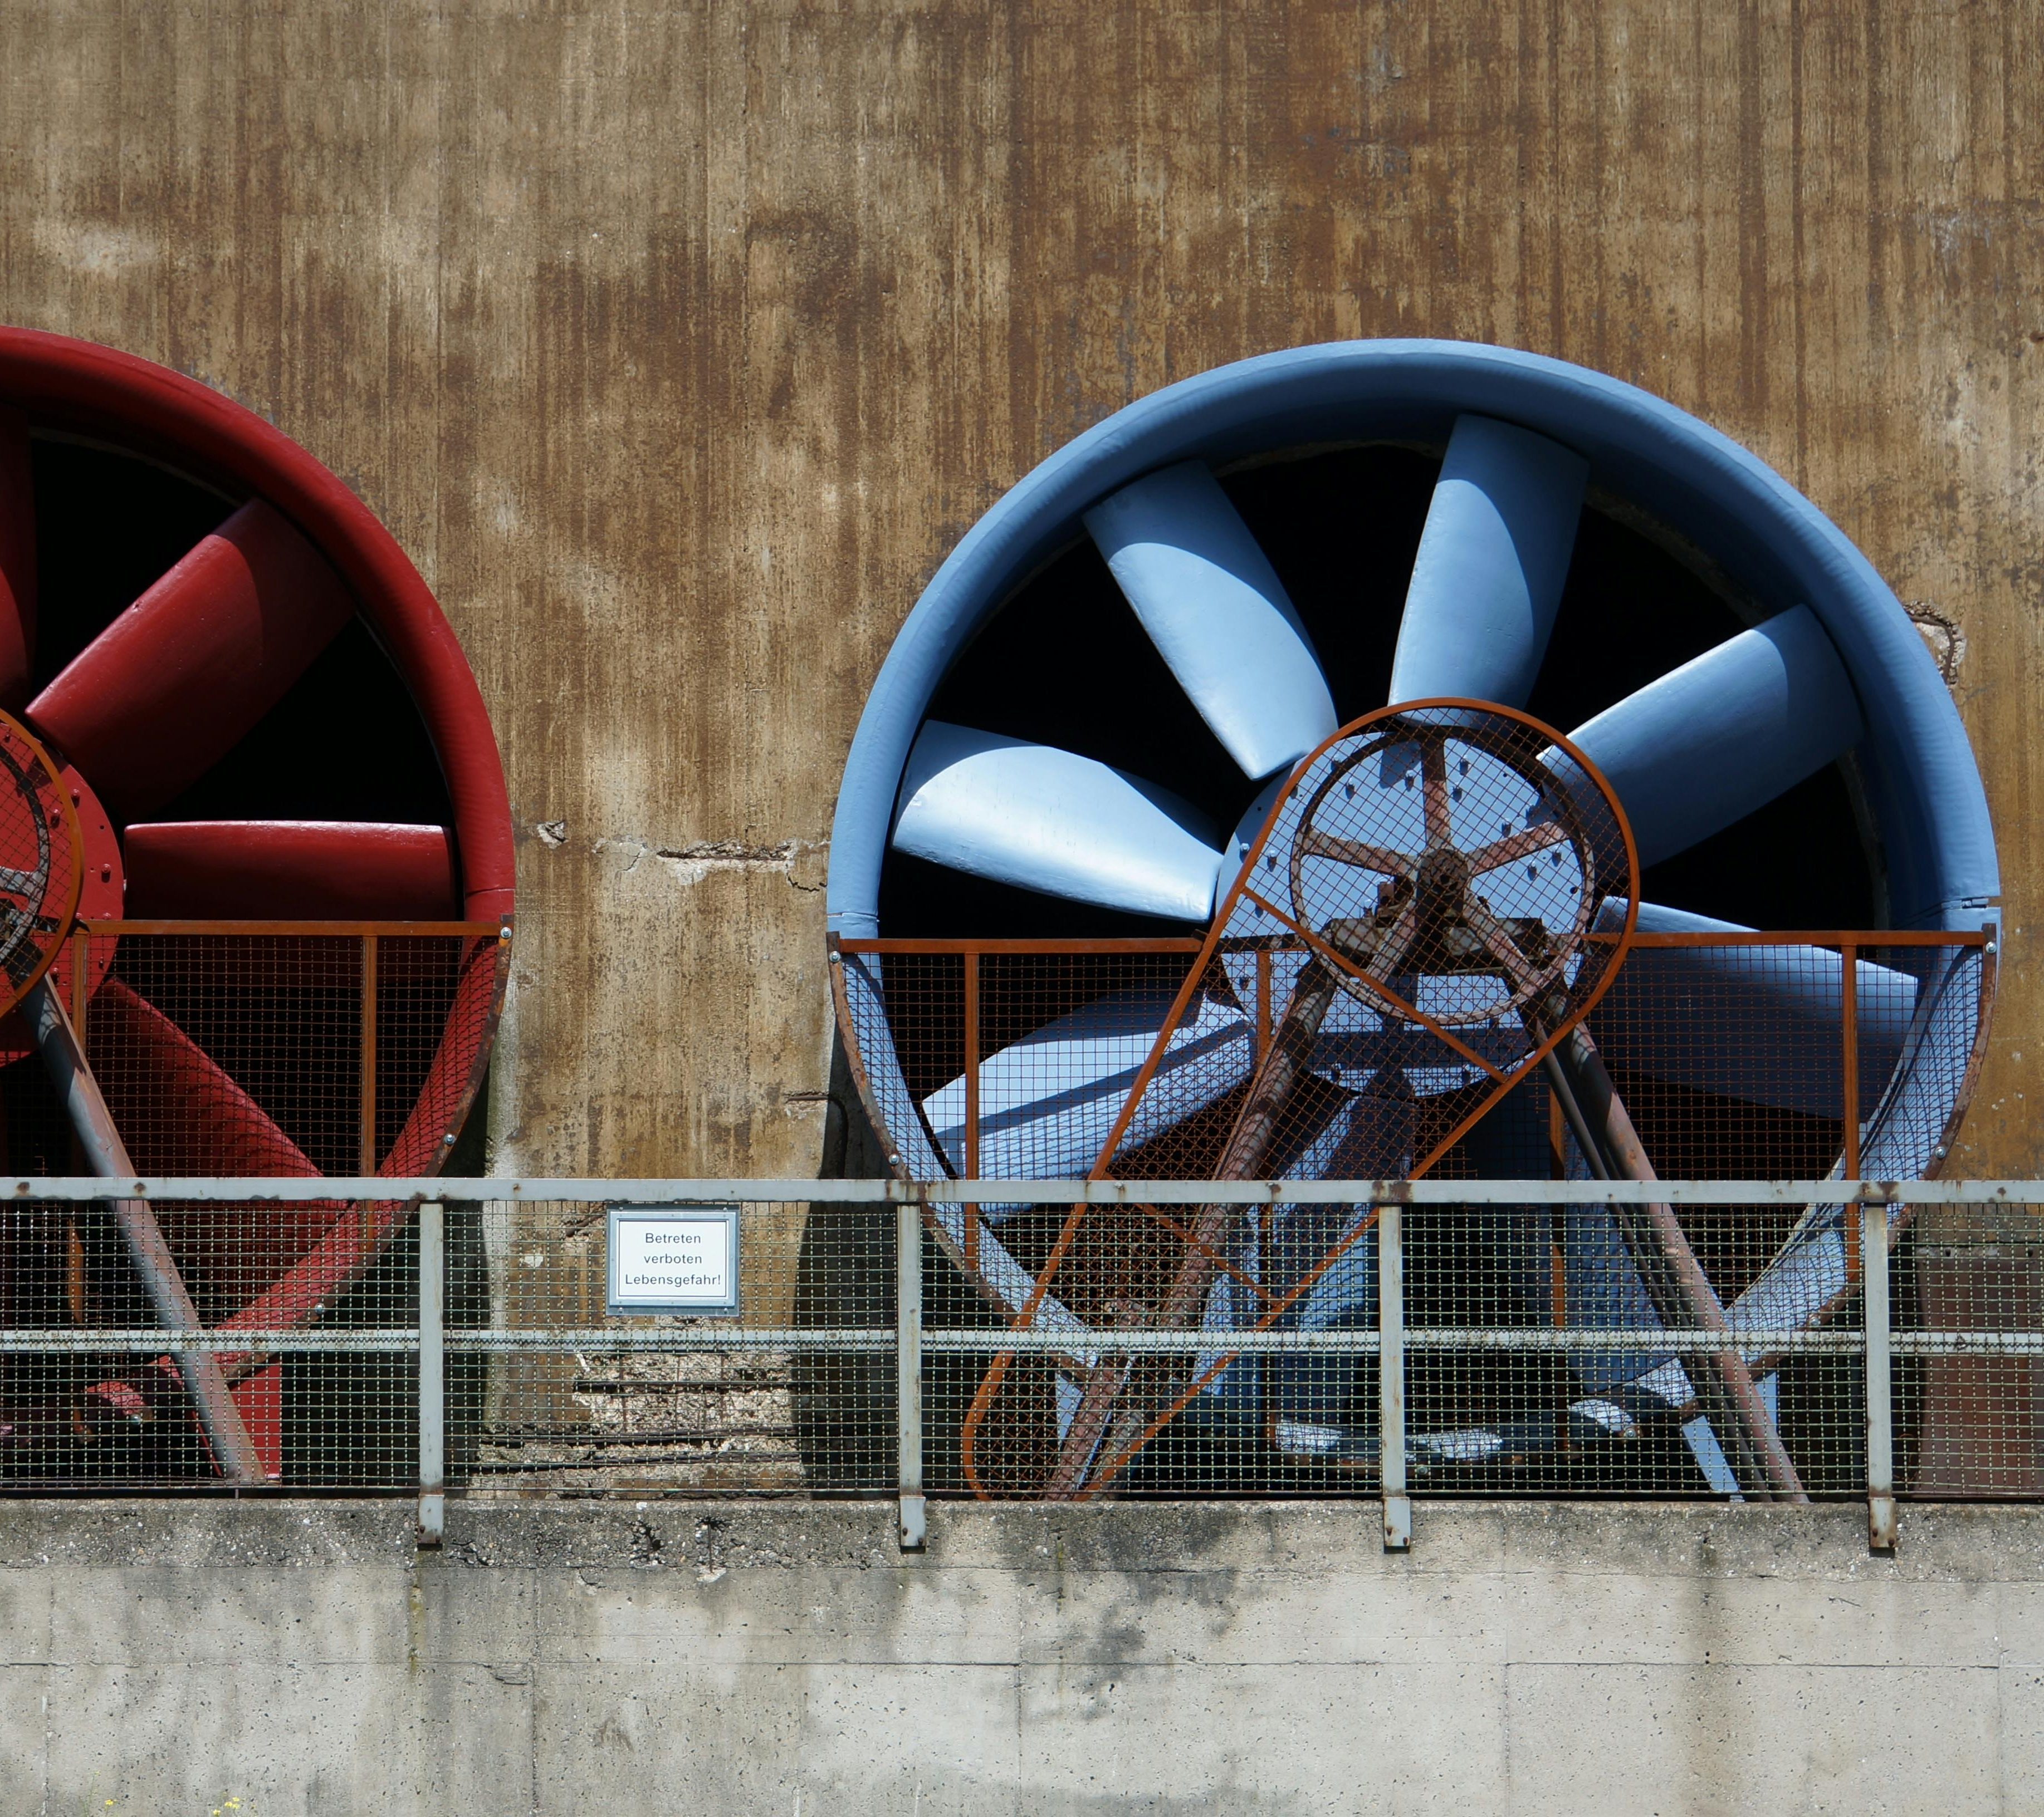
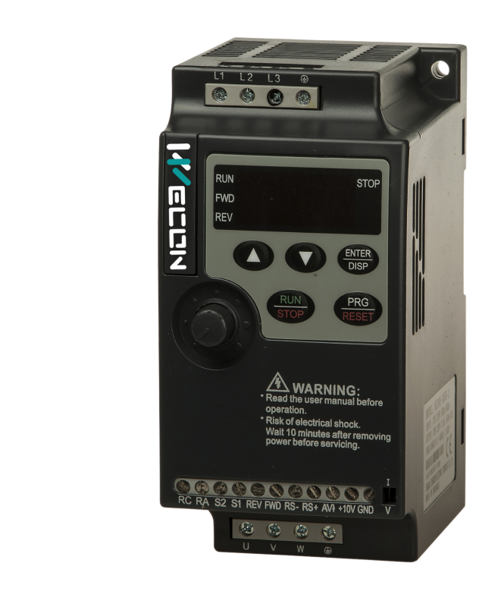
VNZ100
Similar to VM model, It is designed for low power speed regulation application, small size, easy installation and simple debugging.
Compact size and low cost designer
Terminals uncovered, easy for wiring
DIN-rail mounting
V/F control; Bulit-in PID control
Single-phase 220V : 0.4 - 2.2kW
Three-phase 380V : 0.4 - 5.5kW

Slide 23
Input power
VNZ100 HARDWARE
Supply input voltage : single phase , three phase
Operating display
LED Display status , Potentiometer adjust frequency , Button operate
I/O Interface
Supported 4 ch x Digital input ,
1 x Relay output
1 x Analog input (0..10V/4..20mA)
RS485 communication
RJ45 port supported RS485 Modbus RTU
Motor output
Terminal output power to motor U V W

Slide 24
MODEL SELECTION
VNZ100 - 1R5 G - 2
1
2
3
4
1
Series
2
Power
3
Type
4
Voltage
VNZ100 Series
1R5 : 1.5kW
G : Constant torque load
2 : 220V Single phase
R is decimal point
4 : 380V Three Phase

Slide 25
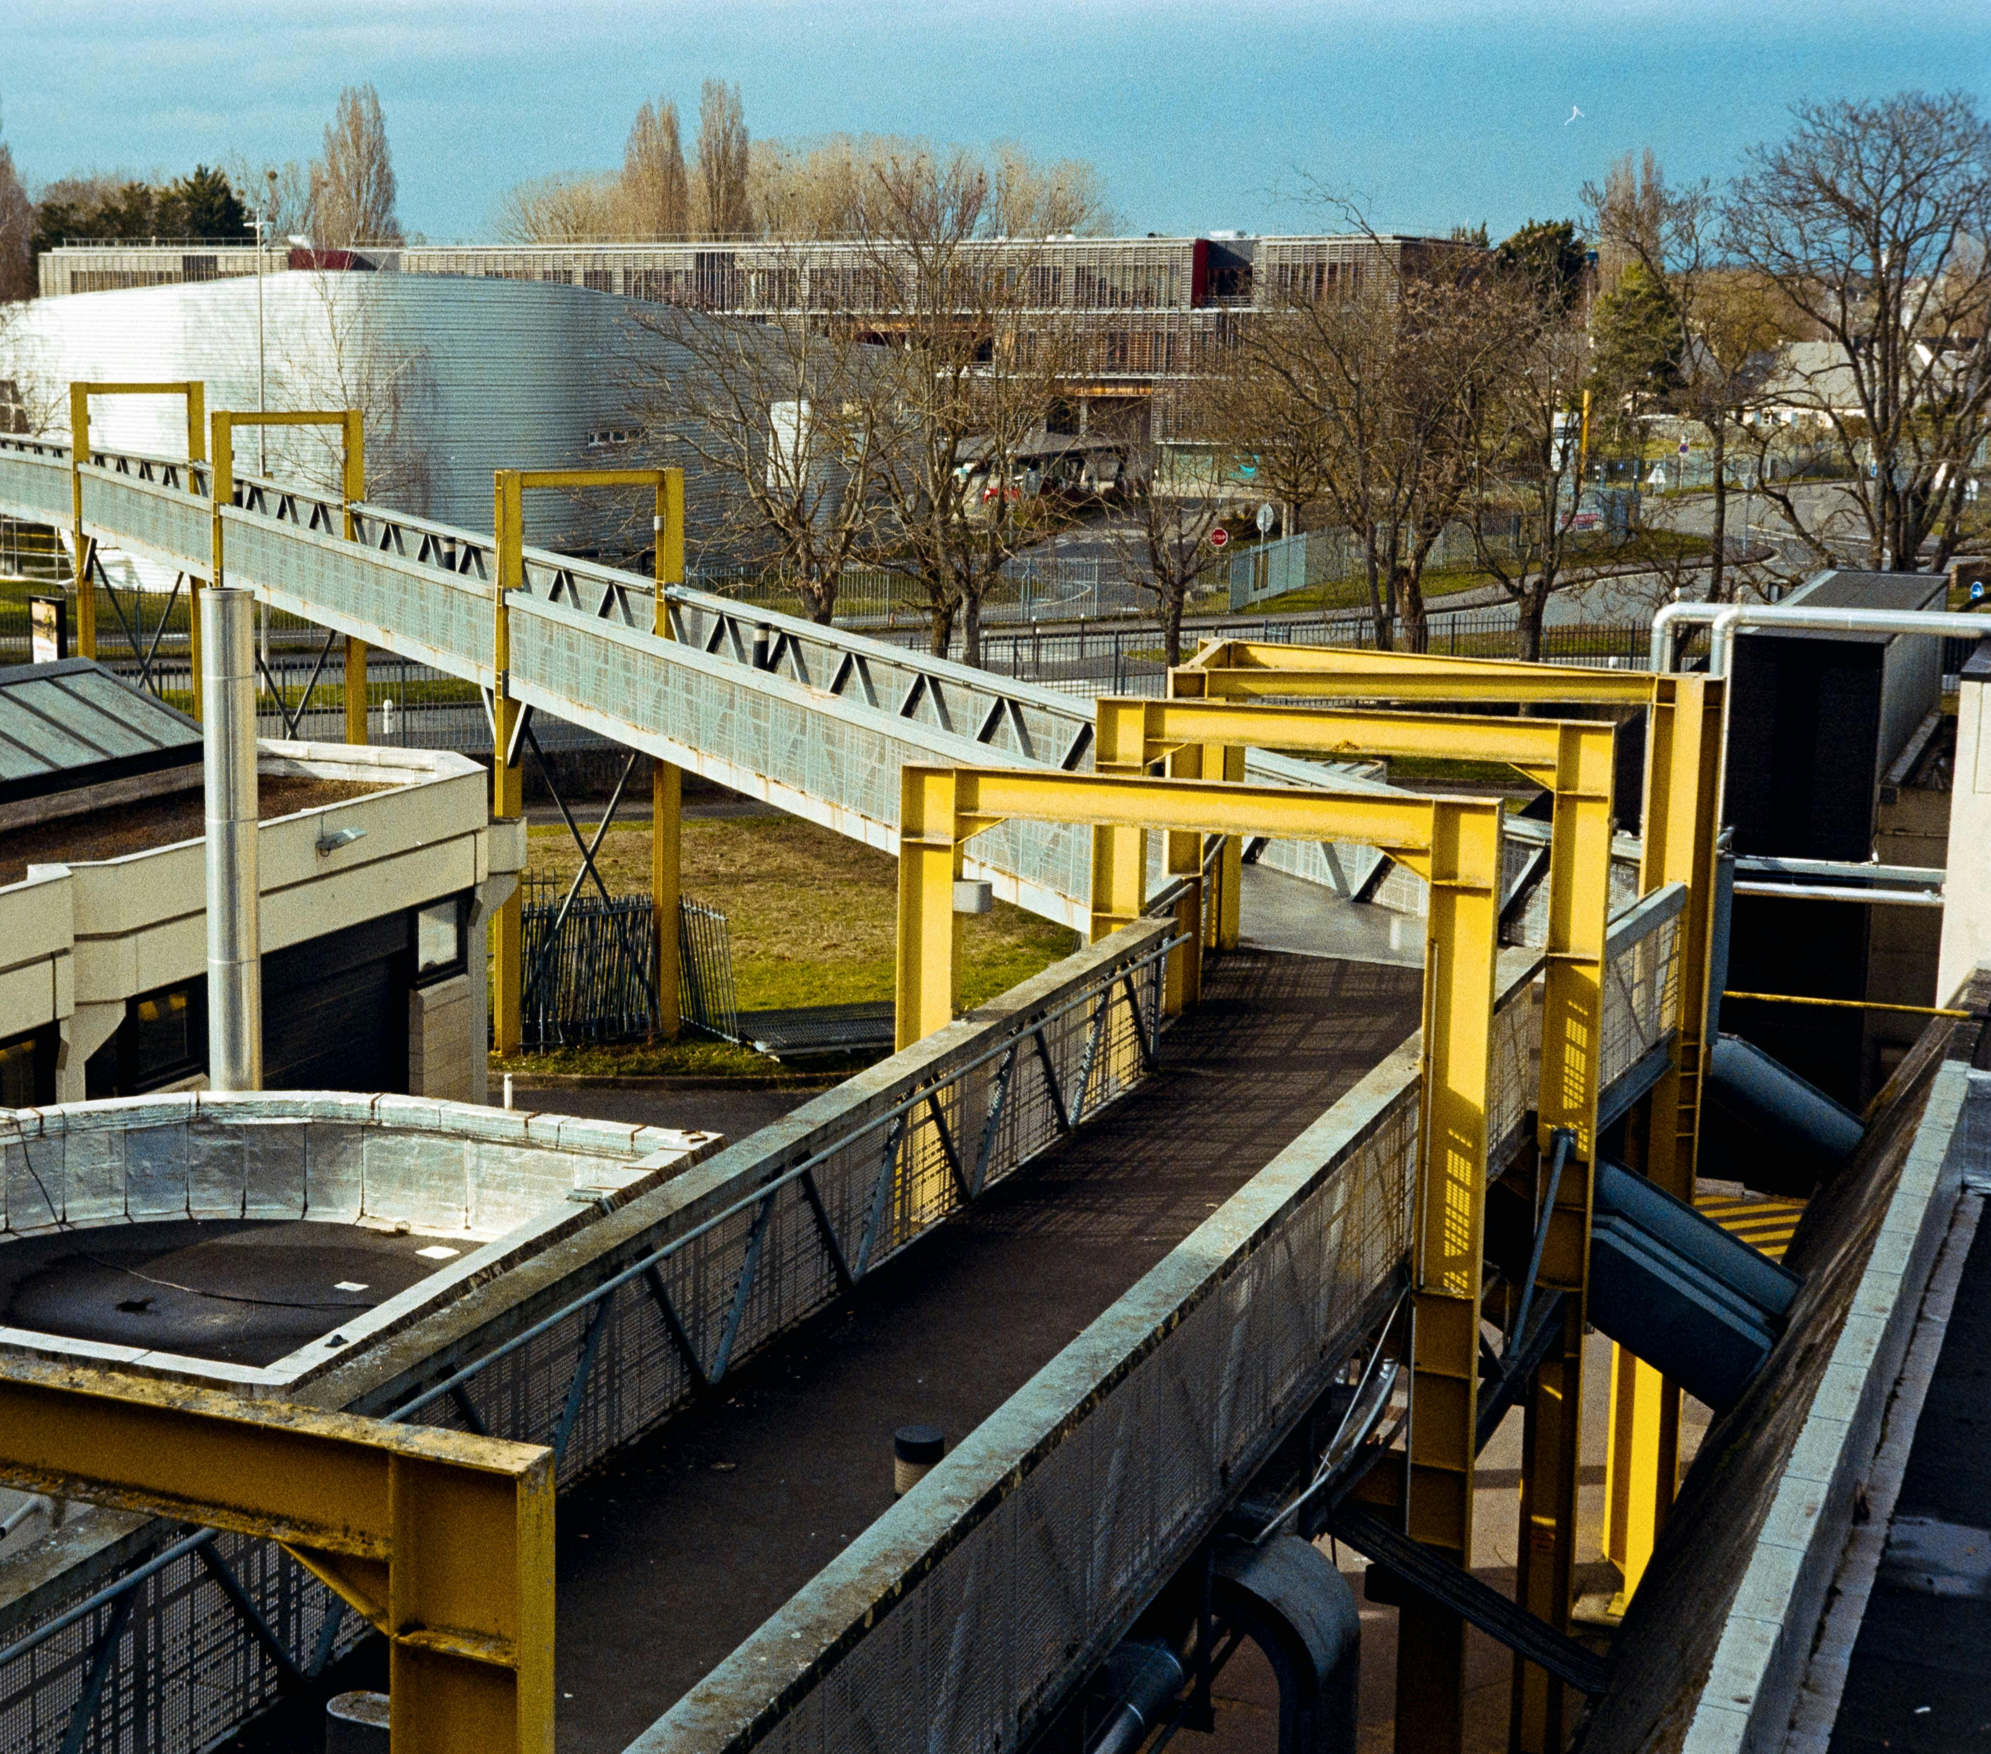
VNZ200
Similar to VB model, standard inverter and support heavy load applications, suitable for high power application.
SVC control, V/F control
150% overload for 60s
Simple structure; Compact size; Easy install
High perforemance; environmental adaptaion
Multiple protection mechanisms, safe and secure
Single-phase 220V : 0.4 - 2.2kW
Three-phase 380V : 0.4 - 450kW

Slide 26
Input power
VNZ200 HARDWARE
Supply input voltage : single phase , three phase
Operating display
LED Display status , Potentiometer adjust frequency , Button operate
I/O Interface
Supported 4 ch x Digital input ,
1 x Relay output
1 x Analog input (0..10V/4..20mA)
1 x Analog output(0..10V)
RS485 communication
RJ45 port supported RS485 Modbus RTU
Motor output
Terminal output power to motor U V W

Slide 27
MODEL SELECTION
VNZ200 - 1R5 G - 2
1
2
3
4
1
Series
2
Power
3
Type
4
Voltage
VNZ200 Series
1R5 : 1.5kW
G : Constant torque load
2 : 220V Single phase
R is decimal point
4 : 380V Three Phase

Slide 28
VNZ200 Model
 | Input Voltage | Range of power(kW) | Po wer level
VNZ200 | single phase 220V | 0.4, 0.75, 1.5, 2.2, 3.7 | 5
 | three phase 380V | 0.4-450 | 29

Slide 29
VNZ200 Terminal
Model | 0.4-37kW | 45-450kW
Input terminal
Digital input | 4 | 6
Analog input | 1 | 2
Modbus input | 1
Output terminal
Digital output | 0 | 1
Relay output | 1 | 1
Analog input | 1 | 2
Power terminal
24V-GND | 0 |  | 1
10V-GND | 1 |  | 1

Slide 30
THANK YOU
CONTACT US TO LEARN MORE
Phone
Email
Online
400-799-8189
sales@we-con.com.cn
www.we-con.com.cn/en

